Slide 1

CSC741 Digital Image Processing Presentation 6
Jessica Gallo & Alex Liew

Slide 2
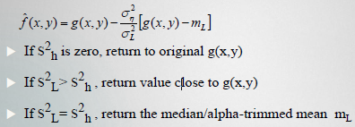
Assignment
Jessica
Generate and add 4 different noise (Gaussian, salt and pepper (impulse) noise to 3 images. You must be able to specify the noise and mean and variance.
Estimate noise parameters from a single image
Apply a class of order-statistics (median, max/min, weighted median, midpoint, alpha-trimmed mean filter) filters on generated noisy images
Alex
Implement an adaptive local noise reduction filter using the following formulas
Implement an image sharpening method by order-statistic (median, max.min, weighted median, midpoint, alpha-trimmed mean filter) filters.
Explain the major differences between your result

Slide 3
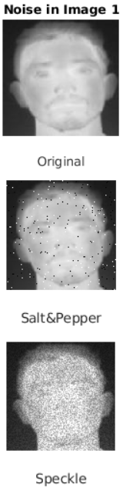
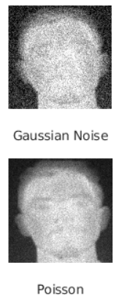
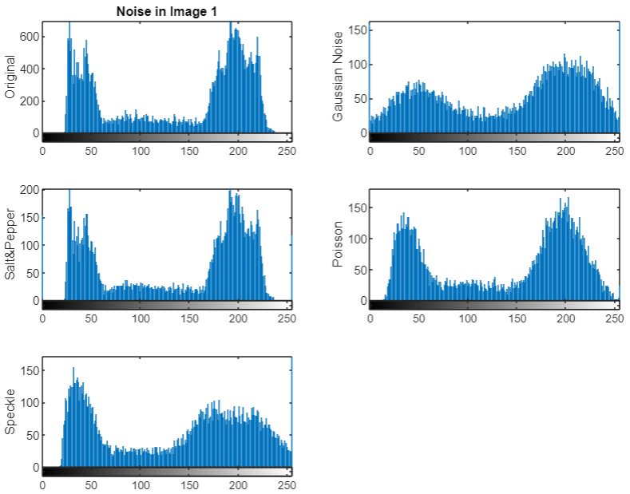



Noise Image 1
Gaussian: mean = 0
variance = 0.02
Salt & Pepper:
density = 0.02
Speckle:
mean = 0
variance: 0.02
Poisson:
mean = intensity values of image

Slide 4
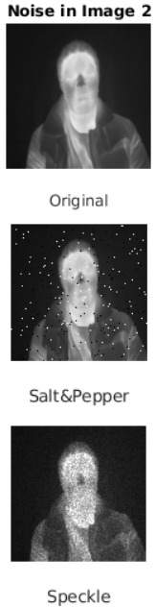
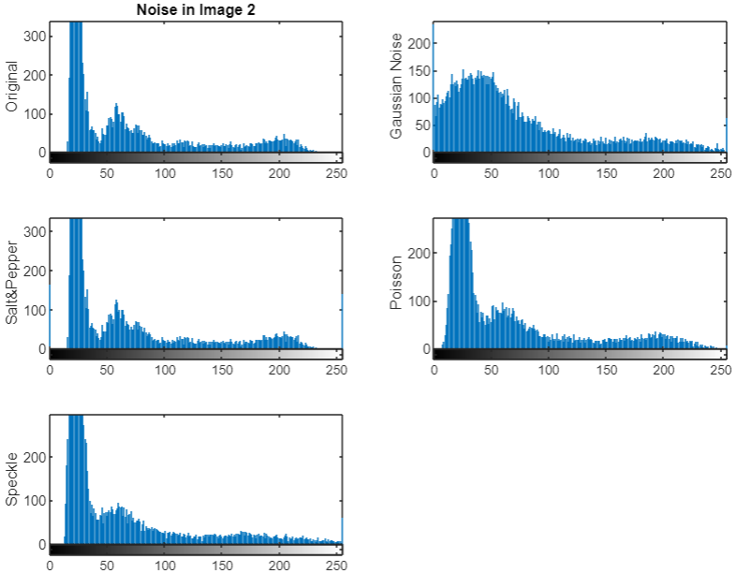
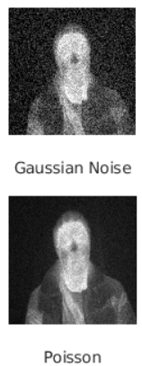
Noise Image 2
Gaussian: mean = 0
variance = 0.02
Salt & Pepper:
density = 0.02
Speckle:
mean = 0
variance: 0.02
Poisson:
mean = intensity values of image

Slide 5
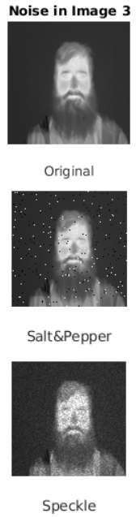
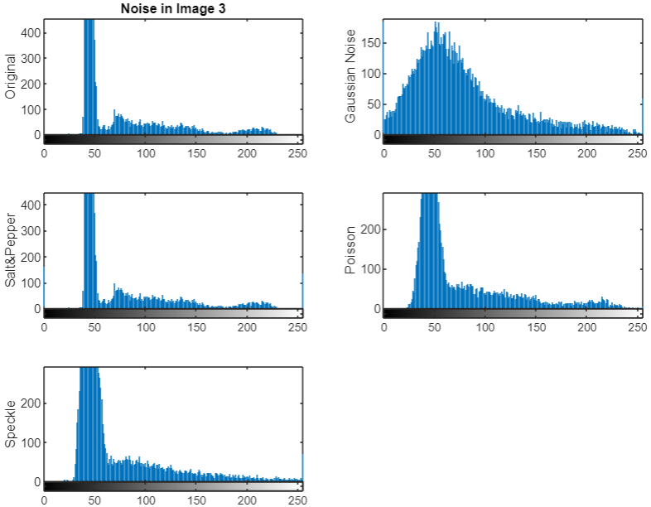
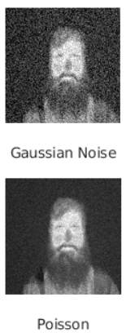
Noise Image 3
Gaussian: mean = 0
variance = 0.02
Salt & Pepper:
density = 0.02
Speckle:
mean = 0
variance: 0.02
Poisson:
mean = intensity values of image

Slide 6
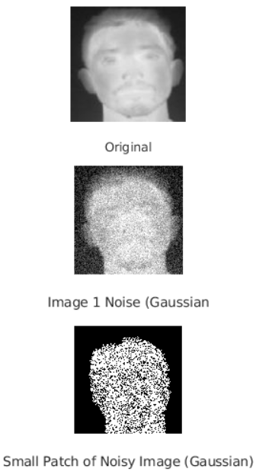
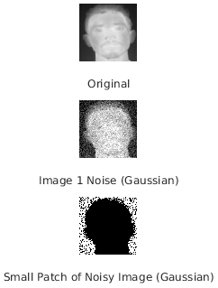
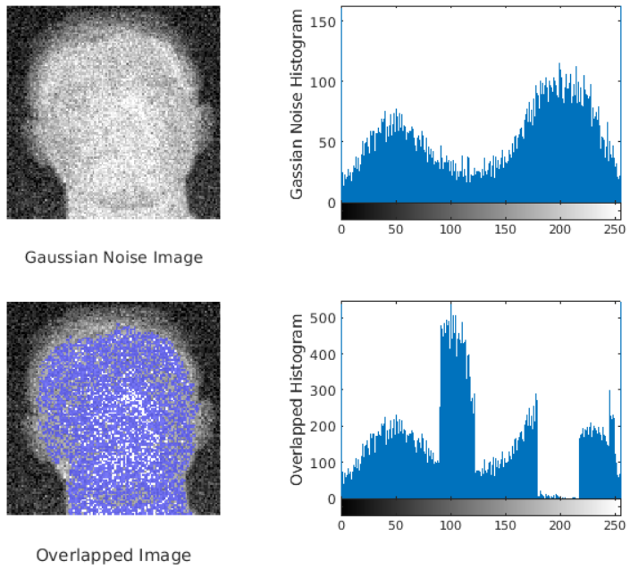
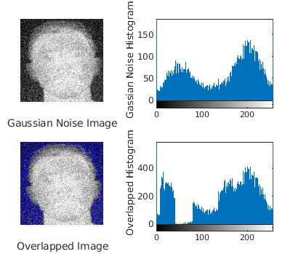




Estimate Noise Parameters
Segment a small patch of image with constant grey level

Slide 7

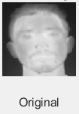
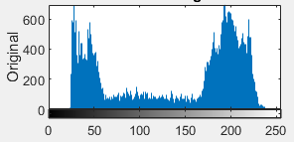
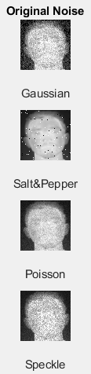
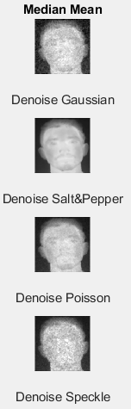
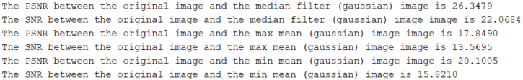
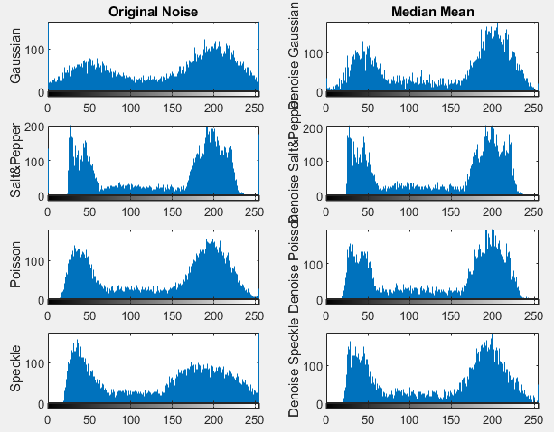
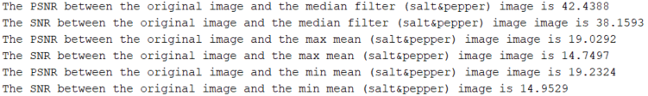
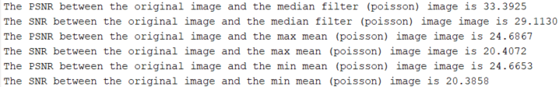
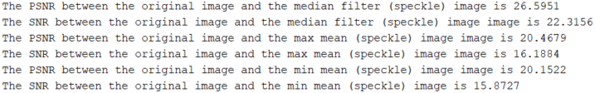
Median Filter
3x3 Mask

Slide 8

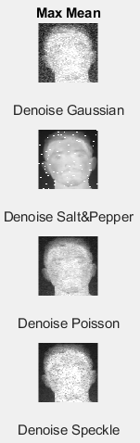
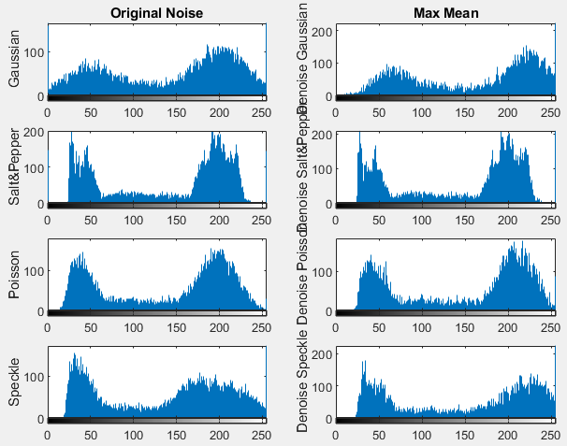
Max Filter
nhood = [010 111 010]

Slide 9

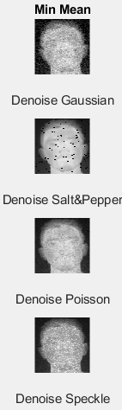
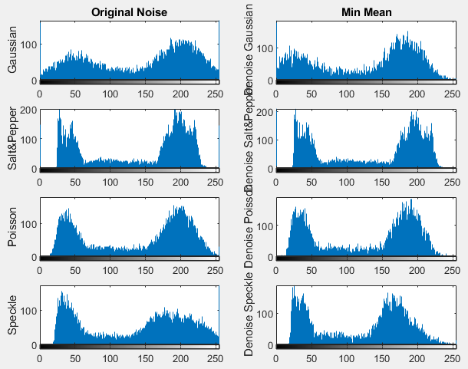
Min Filter
nhood = [010 111 010]

Slide 10

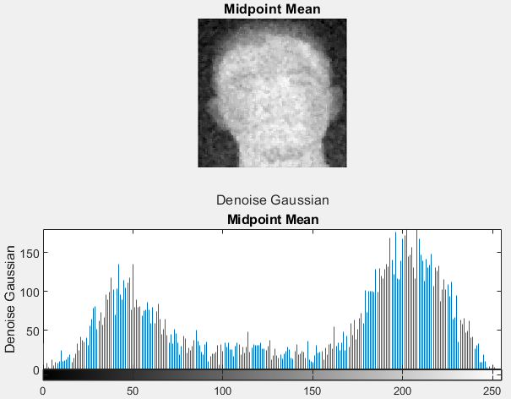
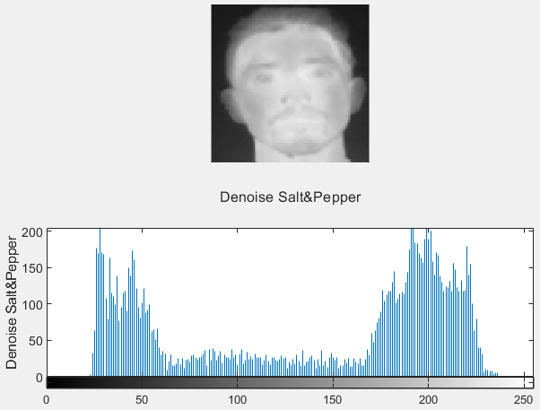
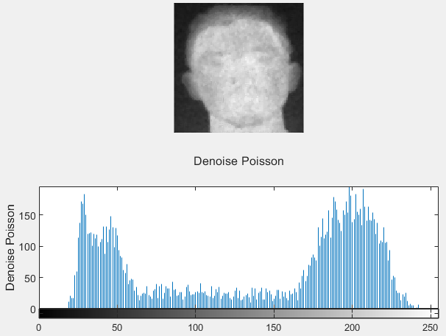
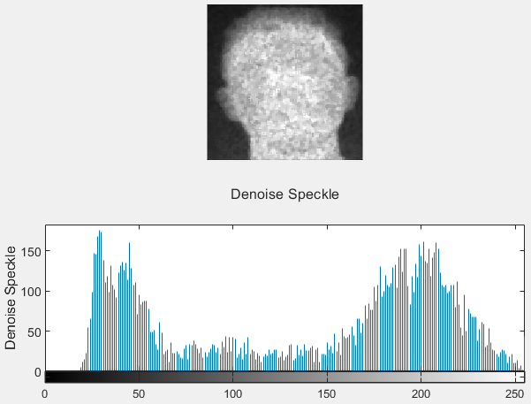
Midpoint Filter

Slide 11
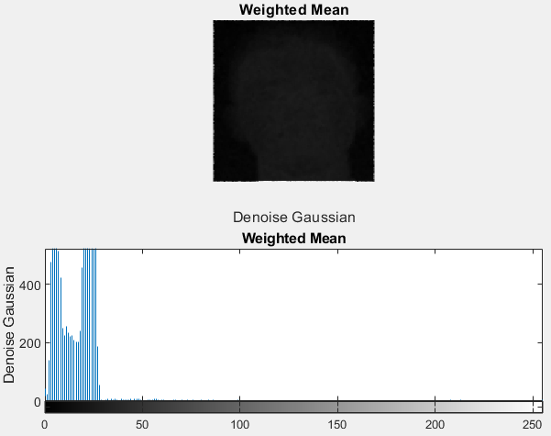
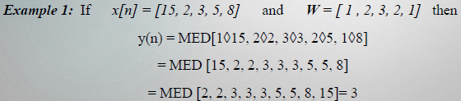
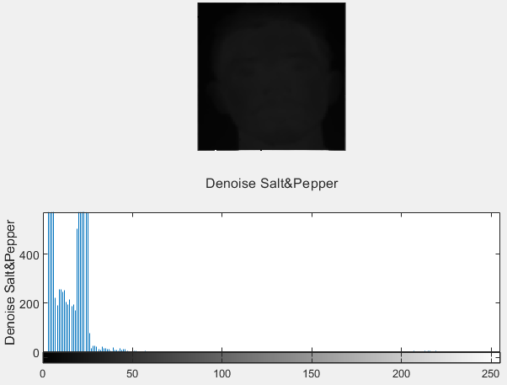
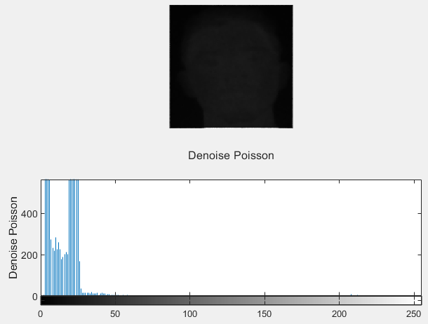
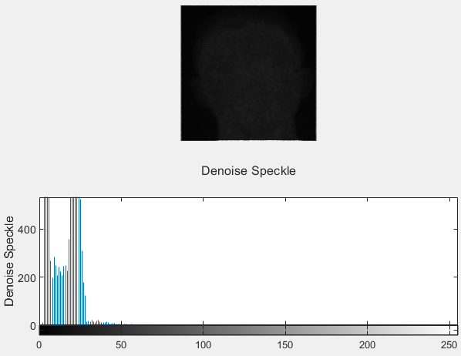
Weighted Median Filter

Slide 12

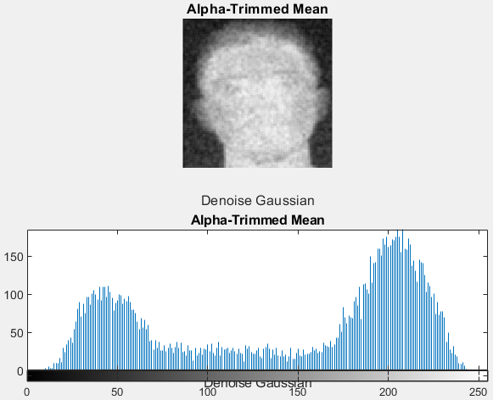
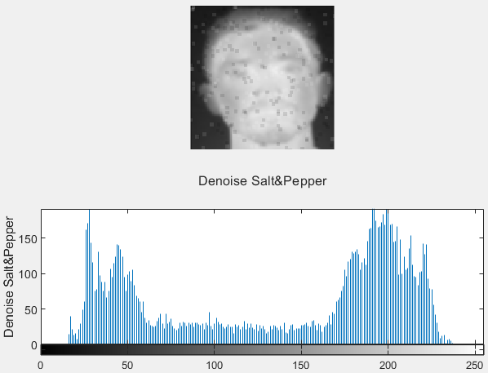
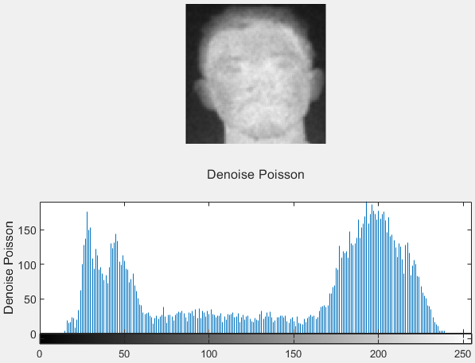

Alpha-Trimmed Mean Filter

Slide 13

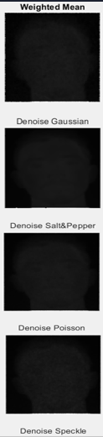
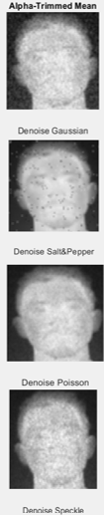
Summary & Conclusions

